Slide 1

INTRODUCTION
The DAVU Placement Management System is a web-based application designed to streamline the placement process for university. It provides a centralized platform where administrators, TPOs, and students can efficiently manage placement activities. The system automates tasks such as posting jobs, tracking applications, uploading resumes, managing company details, and monitoring student eligibility. By integrating modern web technologies, the platform enhances transparency, reduces manual work, and ensures a smoother, faster, and more organized placement experience for all stakeholders.
Notes:
1

Slide 2


Understanding the Need for PMS
A Placement Management System helps universities avoid manual errors, save time, and improve coordination between students, TPOs, and recruiters. It centralizes all placement activities—job postings, applications, resume uploads, and company data—making the entire process faster, organized, and more efficient.
It ensures accurate record-keeping, faster decision-making, improved transparency, and seamless coordination between students, the Training & Placement Office (TPO), and recruiters.
Notes:
2

Slide 3
Key Roles & Streamlined Workflow
Our PMS is designed with distinct user roles, ensuring a smooth and efficient workflow for everyone involved in the placement process.
1
2
Students
TPO Admin
Access job postings, apply to companies, track application status, and manage their profiles.
Manage company registrations, approve job postings, track student applications, and facilitate interviews.
3
4
Management Admin
Super Admin
Oversee placement statistics, generate reports, and gain insights into overall placement performance.
Full control over system configurations, user management, and global settings to ensure seamless operation.
Notes:
3

Slide 4








Powering the Platform: The MERN Stack Advantage
Our Placement Management System leverages the robust MERN stack, a powerful combination of technologies known for its efficiency and scalability.
React.js
Express.js
Dynamic and interactive user interfaces for an intuitive experience.
Fast and unopinionated web framework for backend development.
Node.js
MongoDB
High-performance JavaScript runtime for server-side operations.
Flexible, scalable NoSQL database for efficient data storage.
Notes:
4

Slide 5
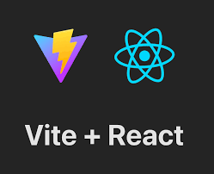
Frontend Excellence: Vite + React.js
The frontend of our PMS is built using Vite and React.js, ensuring a fast, responsive, and highly engaging user experience.
  Vite: Provides a lightning-fast development server and optimized build process.
  React.js: Enables creation of complex, interactive UIs with reusable components.
  Tailwind CSS: For sleek, modern, and fully responsive design across all devices.
Notes:
5

Slide 6
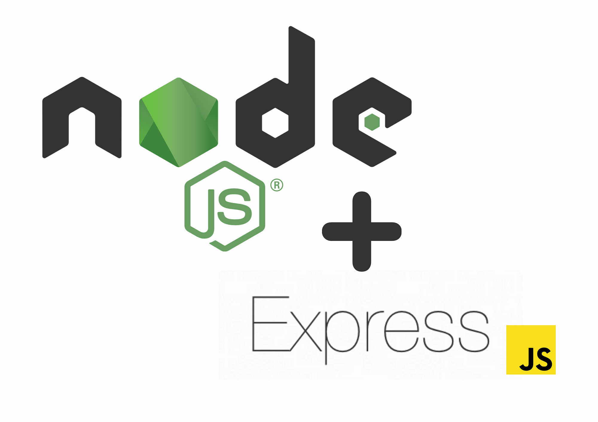




Robust Backend & Database Management
The system's backend and database are engineered for performance, security, and scalability.
Node.js & Express.js
Powerful server-side development for handling requests efficiently and managing business logic.
MongoDB
A flexible NoSQL database allowing for agile data modelling and easy scaling to accommodate growing data needs.
Notes:
6

Slide 7
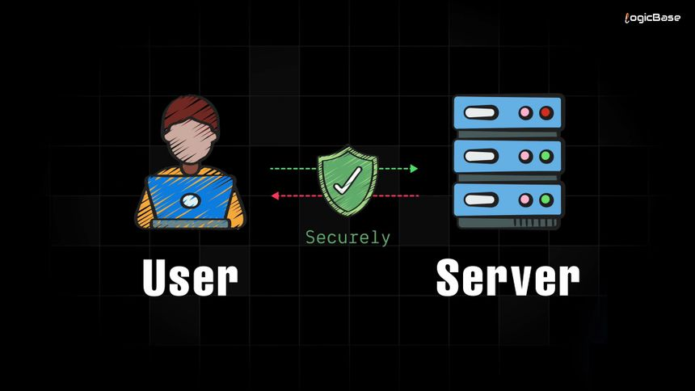



Secure Authentication with JWT
Security is paramount. Our PMS implements JSON Web Tokens (JWT) for secure and reliable user authentication.
User Login
Users provide credentials to authenticate.
Token Generation
Upon successful login, a unique JWT is generated and sent to the client.
Secure Access
The token is used for subsequent requests, granting access to protected resources.
Notes:
7

Slide 8

Sleek and Responsive Styling with Tailwind CSS
Tailwind CSS ensures that our Placement Management System offers a visually appealing and highly responsive design across all devices—desktops, tablets, and mobile phones.
  Utility-First Approach: Rapidly build custom designs without writing custom CSS.
  Responsive Design: Adapts seamlessly to any screen size for optimal viewing.
  Modern Aesthetics: Delivers a clean, professional, and intuitive interface.
Notes:
8

Slide 9




Benefits of DAVU PMS
Implementing our PMS brings significant advantages to the institution.
Enhanced Efficiency
Improved Data Insights
Automate administrative tasks, saving time and resources for your TPO team.
Access comprehensive reports and analytics to track placement performance and identify trends.
Boosted Student Outcomes
Seamless Communication
Empower students with better access to opportunities and a streamlined application process.
Facilitate clearer and faster communication between students, TPO, and companies.
Notes:
9

Slide 10
CONCLUSION
The DAVU Placement Management System successfully streamlines and digitizes the entire placement process, offering an efficient platform for students, administrators, and recruiters. By automating job postings, applications, resume management, and user roles, the system reduces manual effort and improves accuracy.
Overall, it provides a more transparent, organized, and user-friendly experience, contributing to a smoother and more effective placement ecosystem.
Notes:
10

